Slide 1
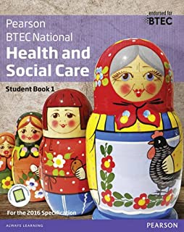
Level 3 BTEC Health and Social Care
Passport to Sixth Form
Name: ________________________
Any questions contact Mrs Palmer
lpalmer@stjosephs.uk.net

Slide 2
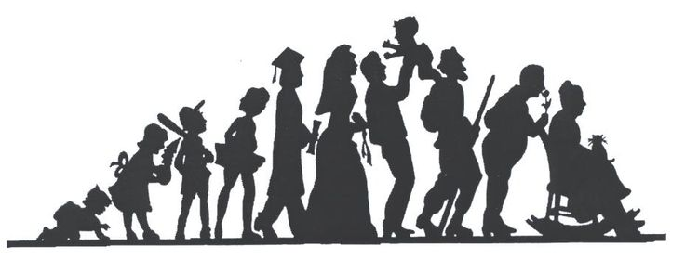
Contents
What will I be studying? Page 3 Recommended Netflix Programmes Page 4 Other recommended watching Page 5 Recommended Reading Page 6 Representations Task Page 7-8 Key word Glossary Page 9-10 A-Z Challenge Page 11 History of the NHS Page 12 Roles in Health and Social Care Page 13 Frontline roles in a pandemic Page 14 True or False Page 15 Checklist for September Page 16

Slide 3
What will I be studying?
This course allows you an insight in the many roles available within health and social care from nurses to social workers to childcare assistants and beyond they have many key features that we shall explore and apply. You will be studying a range of units which will help you to gain skills that will be valuable in your chosen profession or future study. You will learn about the human body and mind alongside the changes across time. You will learn what it means to work in the sector and what skills and behaviours you will need to develop. We will study the following units; although the final one is subject to change and you may not study them in this order.
During unit one, Human Lifespan Development, you will focus on:
Understand the different influences on an individual’s development and how this relates to their care needs.
You will be introduced to the biological, psychological and sociological theories associated with human lifespan development.
You will explore the physical effects of ageing and the theories that help to explain psychological changes.
How you will be assessed: EXAM - 1 hour 30 minutes, that is worth 90 marks. There is a variety of short- and long- answers. The questions are designed to test your knowledge on individual’s development, the factors that affect this and the theories that explain this.
During unit two, Working in Health and Social Care, you will focus on:
You will be introduced to the roles and responsibilities of health and social care practitioners and the organisations they work for.
You will see how a wide range of roles, including doctors, nurses, physiotherapists, occupational therapists, social workers, youth workers, care workers and other professionals, work together to ensure that the individual needs of vulnerable people are met.
How you will be assessed: EXAM - 1 hour 30 minutes and worth 80 marks. There will be four sections and include short- and long- answers. The questions are intended to assess your understanding of how health and care services who need professional support. Each section will relate to a different service user group, for example the frail elderly, people with learning disabilities, people with mental health problems or people with long-term illnesses.
During unit five, Meeting Individual Care and Support Needs, you will focus on:
You apply knowledge in order to provide the care and support that meets the needs of an individual in a health and social care environment, for this you need to understand the principles and practicalities that are the foundation of all the care disciplines.
You will need to consider ethical issues that may arise and challenges the individual may face in order to provide personalised care.
You will reflect on the different methods used by professionals working together in a multi-agency team to provide a package of care and support that meets individual needs.
Assessment: by a series of assignments set at school. You will be given practice assignments to help you prepare for the final assessment. You will need to check that your work first meets all the pass criteria before moving on to merit and then finally distinction criteria.
The final unit will also be a series of assignments based on in class work exploring a specific aspect of health e.g. physiological or psychological care. You will need to look at case studies as you did in unit five and use your knowledge to explain their behaviour or condition leading to treatment plans.

Slide 4
Babies
Marriage Story
Five Feet Apart
Brain on Fire
Theory of Everything
Pandemic: How to prevent an outbreak
Fab watching for Health and Social Care

Slide 5
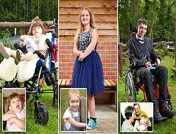
Beyond
Rio & Kate: Becoming a Step family
Jesy Nelson: Odd one out
Bohemian Rhapsody
BBC iPlayer
DVD
Geordie hospital
Born to be different
Still Alice
4 On Demand
DVD
The Children Act
The Upside
Beautiful Boy
Miss you Already
Amazon Prime

Slide 6
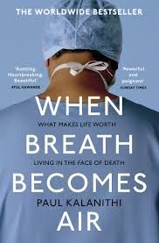
Beyond
Pig Heart Boy by Malorie Blackman
Wonder by R.J. Palacio
This is Going to Hurt by Adam Kay
When Breathe becomes Air by Paul Kalanithi
Further Reading
The Hate U Give by Angie Thomas
Me Before you by Jojo Moyes
The Fault in Our Stars by John Green
The Story of Baby P by Ray James
Savage Girls and Wild Boys by Michael Newton
The Language of Kindness by Christie Watson
I am Malala by Malala Yousafzai
The Boy Who Couldn’t Stop Washing by Dr Judith Rapaport
Recommended Reading for Health and Social Care
Yes some of these are also films, if you prefer!

Slide 7
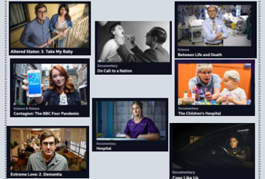
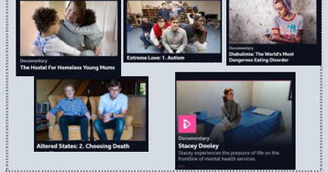
Health and Social Care in the Media
It is important to make the public realise about the issues which are prevailing in society relating to health and social care. One way in which public awareness is raised about health and social care in general and issues that exist within the health and social care sector is through the media. Your task is to pick… ➢ x1 Film ➢ x1 Book ➢ x1 Documentary You will then be asked to write an essay with the following title: ‘Discuss the portrayal of Health and Social Care within the media’ Use the examples on the previous slides or look for alternatives and create notes to help with your essay. Consider the following: What issues, if any, are being raised in the stimulus? How does the stimulus present H&SC? Is the stimulus informative/helpful and why? Are there any quotes/scenes etc that stand out to you and why? How effective is the stimulus in raising public awareness about H&SC/Issues? This list is NOT exhaustive there may be other questions/ideas you wish to consider as you watch or read.
Documentary Suggestions:

Slide 8
Essay - ‘Discuss the portrayal of Health and Social Care within the media’.
______________________________________________________________________________________________________________________________________________________________________________________________________________________________________________________________________________________________________________________________________________________________________________________________________________________________________________________________________________________________________________________________________________________________________________________________________________________________________________________________________________________________________________________________________
______________________________________________________________________________________________________________________________________________________________________________________________________________________________________________________________________________________________________________________________________________________________________________________________________________________________________________________________________________________________________________________________________________________________________________________________________________________________________________________________________________________________________________________________________
______________________________________________________________________________________________________________________________________________________________________________________________________________________________________________________________________________________________________________________________________________________________________________________________________________________________________________________________________________________________________________________________________________________________________________________________________________________________________________________________________________________________________________________________________
______________________________________________________________________________________________________________________________________________________________________________________________________________________________________________________________________________________________________________________________________________________________________________________________________________________________________________________________________________________________________________________________________________________________________________________________________________________________________________________________________________________________________________________________________

Slide 9
Task: Research and define the following words which are central to H&SC. Then, draw a symbol to summarise the term and help you remember it.
Term | Definition | Symbol
Adolescence | An important status change following the onset of puberty during which a young person develops from a child into a adult.
Advocate
Attachment
Care package
Clinical Commissioning Groups (CCGs)
Development
Discrimination
Diversity
Empathy
Ethical

Slide 10
Term | Definition | Symbol
Fine Motor Skills
Growth
Holistic Approach
Milestone
Nature
Nurture
Risk Assessment
Safeguarding
Self-Concept
Self-Esteem

Slide 11
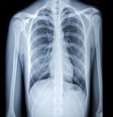
Research a list of Health and Social Care jobs/ medical terms for each letter of the alphabet
A B C D E F G H I J K L M | N O P Q R S T U V W X Y Z

Slide 12
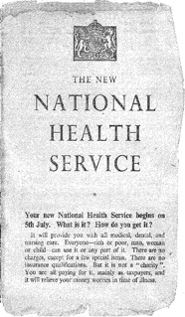
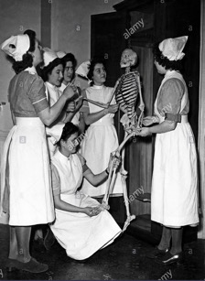
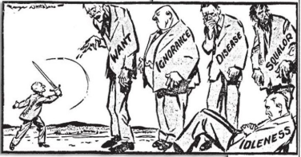
History of the NHS
Make a leaflet outlining the history of the NHS
Include sections on:
Healthcare before the NHS
When/ why the NHS was produced
What the NHS does
Significance of the NHS
How is the NHS different in other countries
The Beveridge Report, 1942
In 1942, a plan had been presented by William Beveridge, a senior civil servant, detailing key areas for post-war reconstruction, aimed at establishing a national system of welfare for the people. It identified ‘five giants’ that were to be overcome: want, disease, ignorance, squalor and idleness.
When the Beveridge Report first appeared, it was welcomed by all the parties. There was broad agreement that protection needed to be provided for all members of society, and so when Labour came to power in 1945, they implemented the proposals in this report, thereby establishing the welfare state, a system which all governments after 1951 accepted in its essentials. This common acceptance became known as consensus.
Giant | The 1945 Labour Government’s Solution
Want | To be ended by National Insurance. The National Insurance Act created a system whereby the government, employers and employees all paid for insurance which would pay out in the event of unemployment, sickness, maternity and retirement.
Disease | To be ended by a comprehensive health service. The National Heath Service Act provided free medical and hospital treatment for all (the NHS).
Ignorance | To be ended by an effective education system. The Labour Party continued to support the Conservative’s 1944 Butler Education Act which provided free education within grammar schools, technical schools or secondary schools.
Squalor | To be ended by slum clearance and rehousing
Idleness | To be ended by full employment
The idealism that inspired the government’s welfare programme came at a heavy financial cost, which added to the financial burdens it inherited in 1945.

Slide 13
Research task
Chose a professional from the following:
Midwife
Paramedic
Paediatric nurse
Nutritionist
Physiotherapist
You could choose your own idea from health and social care roles if you prefer.
Create a fact file for your chosen job role
You could include:
A day in the life of……
General roles and responsibilities
Routes into the role/ qualifications required
Skills & qualities
Average pay
Where they work
Who they work with
And anything else you think may be suitable

Slide 14
Job role fact file

Slide 15
On ‘The front line’…….
What does it mean when people talk about being ‘on the front line’?
Government declares a ‘pandemic’…….
What does it mean when people talk about the situation as a pandemic?
Job Role | Definition | Roles and Responsibilities | How do they respond in a pandemic?
District Nurse
Auxiliary Nurse
Palliative Care
Phlebotomist
Domiciliary Carer
Adult Social Worker

Slide 16
True or False?
Colour code the statements in order to show if they are true or false.
True False
A palliative care nurse will get involved with everyone who gets coronavirus.
A district nurse will only work with the elderly.
Adult social workers support people with poor mental health.
Domiciliary carers provide care in the home.
Only phlebotomists are allowed to take blood.
Auxiliary nurses help support other nurses to do their roles.

Slide 17
Passport to Sixth Form Check list
Use this list to make sure you have everything you need to hand in in September in order to start your Level 3 BTEC in Health and Social Care.
Essay about representations in the media Pg. 8
Completed glossary of key terms, page 9-10.
Filled in A-Z of Health and Social Care, page 11.
Leaflet on the history of the NHS, page 12.
One fact file on a role within the H&SC sector, Pg. 13-14.
Completed front line roles table, page 15.
Highlighted true or false sheet, page 16.

