Slide 1
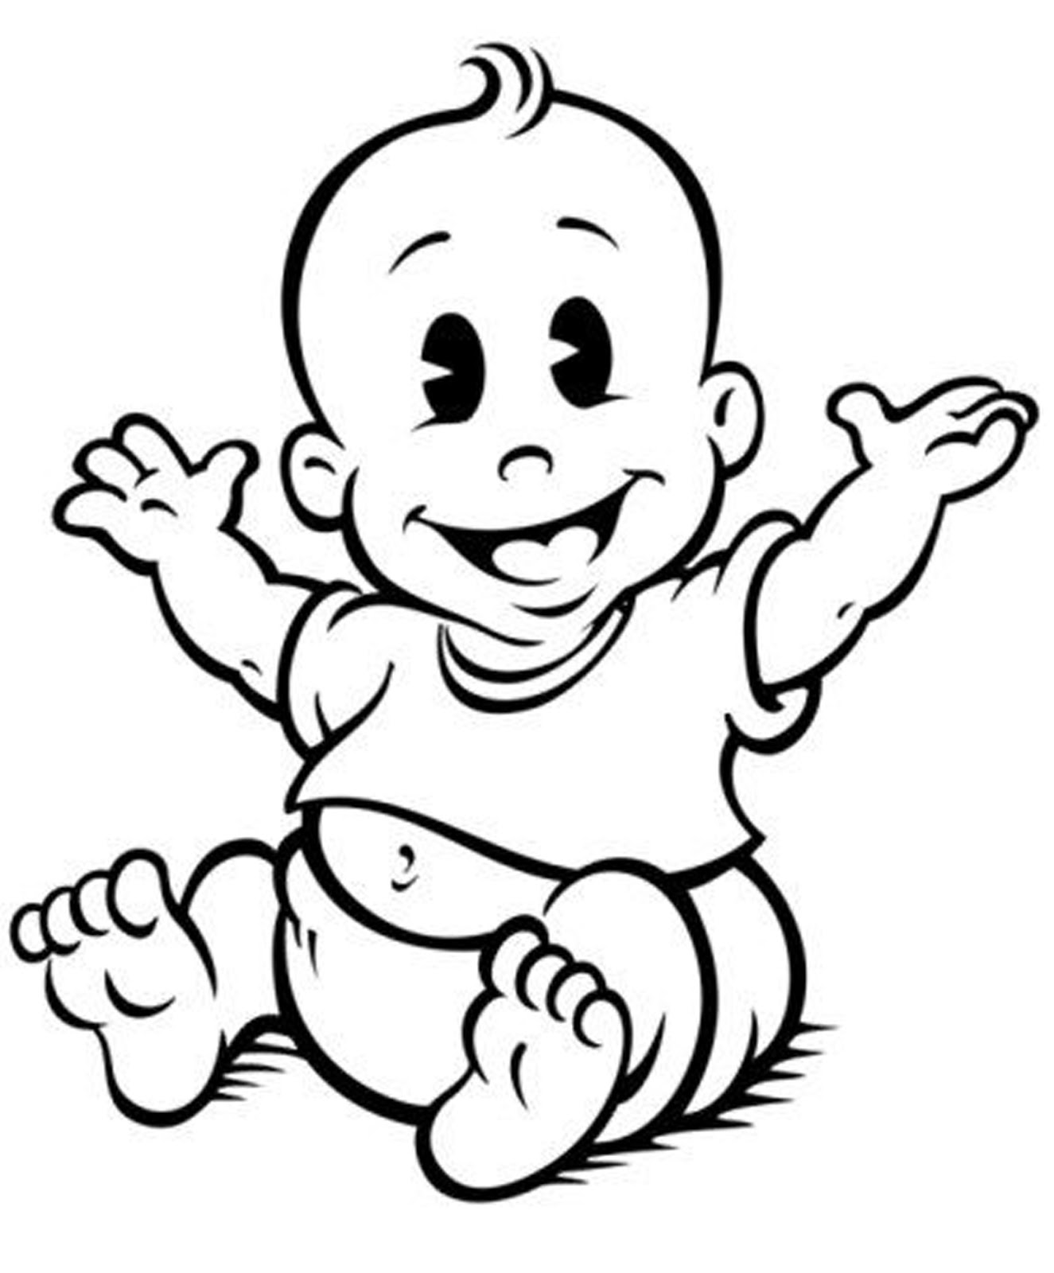
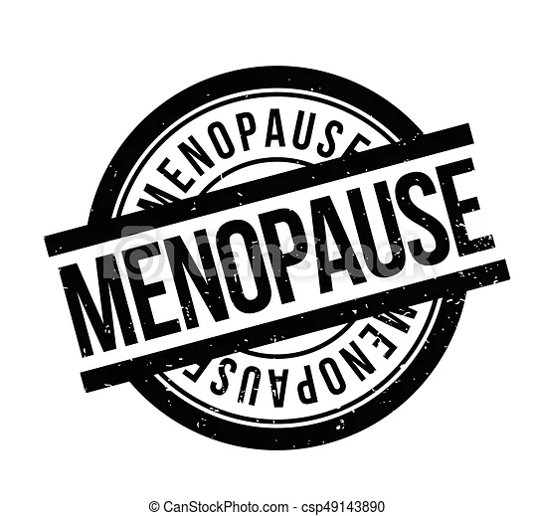
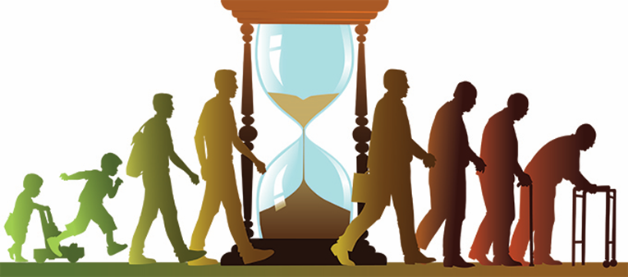
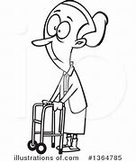
Unit 1: Human Lifespan Development
Topic Summary:
You will be introduced to the biological, psychological and sociological theories associated with human lifespan development. You will explore the PIES development across someone’s lifespan. Examining the factors that affect growth and development such as the environment or genetic inheritance and consider the positive and negative influences on development.
Learning Assessment:
A: Human growth and development through life stages.
B. Factors affecting human growth and development.
C. Effects of ageing.
Growth = an increase in some measured quantity e.g. height or weight
Development = complex changes such as an increase in skills, abilities and capabilities.
Physical Development
Infancy (0-2) – development of gross and fine motor skills. Milestones are: sitting, standing, cruising, walking.
Early childhood (3-8) – further develops motor skills, e.g. gross (running, hopping, skipping) and fine (turning pages, joined up writing)
Adolescence (9-18) – primary and secondary sexual characteristics. Role of hormones in sexual maturity.
Early adulthood (19-45) – physical maturity. Pregnancy and lactation occur. Perimenopause.
Middle adulthood (46-65) – female enters menopause. Effects of ageing.
Later adulthood (65+) – health and intellectual abilities can deteriorate.
Intellectual Development
Infancy and early childhood – rapid growth in intellectual and language skills.
Piaget (logic and reasoning) – stages of cognitive development, schemas, test of conservation, egocentrism.
Chomsky – Language Acquisition Device (LAD).
Early adulthood – thinking becomes realistic and pragmatic, with expert knowledge about practical aspects of life that permits judgement about important matters.
Later adulthood – memory loss.
Emotional Development
Infancy and early childhood – attachment to care-giver.
Theories – Bowlby (1958) and Ainsworth (1978)
Self-concept – Knowledge of who we are.
Self-esteem – how confident a person feels about themselves.
Self-image – how you see yourself.
Nature/Nurture Debate
Development is a result of genetic or inherited factors - Gesell’s maturation theory
Development is a result of environmental factors – Bandura’s social learning theory.
Both factors play a part – stress-diathesis model.
Social Factors
Family dysfunction – parental divorce or separation, sibling rivalry, parenting style.
Bullying – effects of bullying on self-esteem, self-harm, suicide.
Effects of culture, religion and belief – beliefs may prevent medical intervention, dietary restrictions.
Genetic Factors
Genetic predispositions to particular conditions –e.g. cystic fibrosis, phenylketonuria (PKU), Huntington’s disease etc.
Biological factors – foetal alcohol syndrome, maternal infections, lifestyle/diet during pregnancy, congenital defects.
Economic Factors
Income and expenditure e.g. lack of income = lack of affordable resources
Employment status – jobs depending on demand, availability etc. Has an impact on someone's wellbeing.
Education – poorer children are disadvantages compared to their wealthier peers.
Lifestyle – choices made on how we spend our time can significantly impact someone’s life. E.g. smoking can lead to health conditions, financial difficulty etc.
Environmental Factors
Air pollution – respiratory disorders, cardiovascular problems, allergies.
Poor housing conditions – respiratory disorders, cardiovascular problems, hypothermia, anxiety and depression.
Access to health and social care services – availability of transport, opening hours of services, ability to understand the needs and requirements of particular services.
Social Development
Stages of play – solo, parallel, simple cooperative, complex co-operative.
Importance of friendships – social benefits. Effects of peer pressure.
Development of relationships with others.
Development of independence -peer influence in adolescence, starting employment, leaving home, starting a family.
Life events
Predictable – expected to happen at a particular time. E.g. going to school, getting a job.
Unpredictable – not expected to happen, can have serious effects. E.g. imprisonment, divorce.
Holmes-Rahe social readjustment rating scale

Slide 2
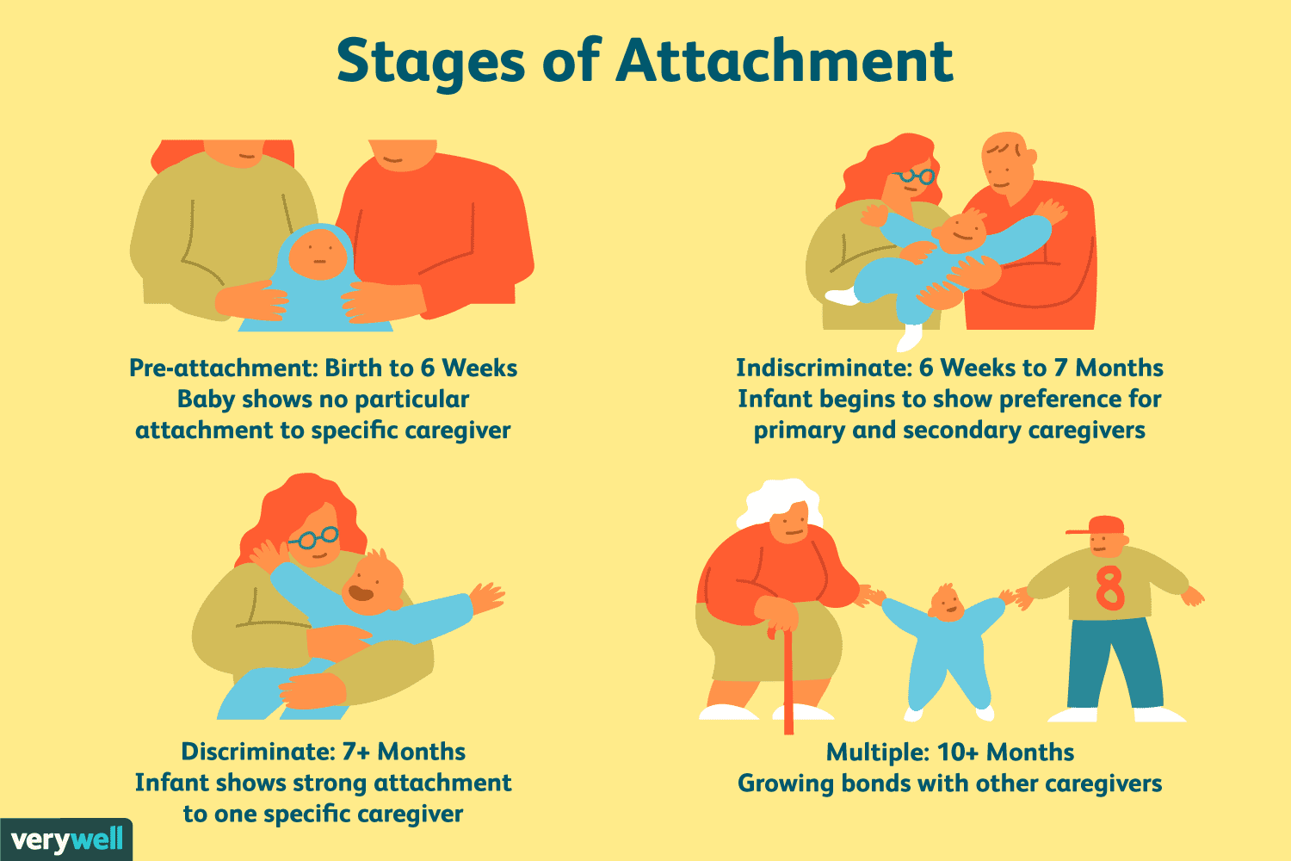
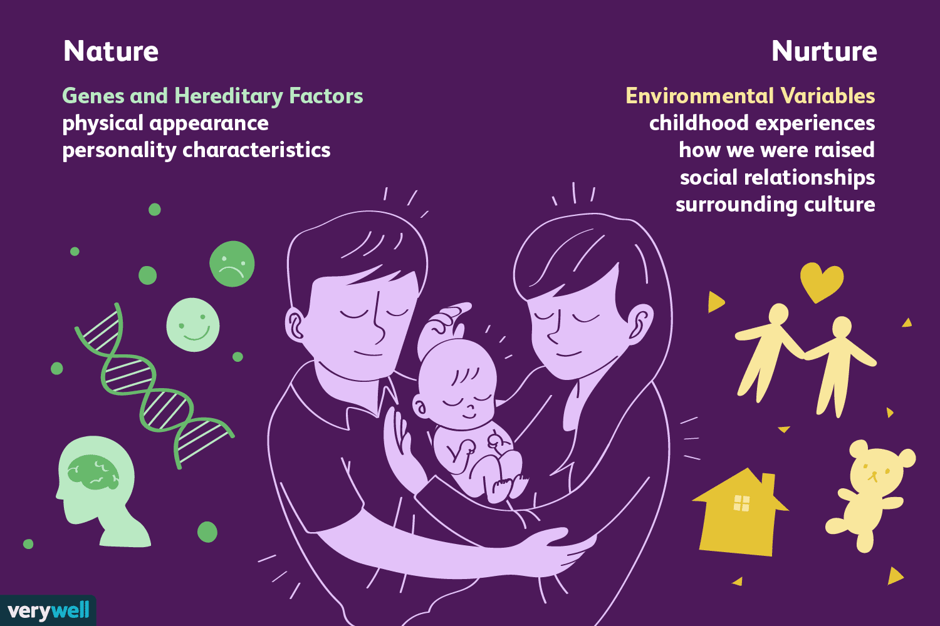
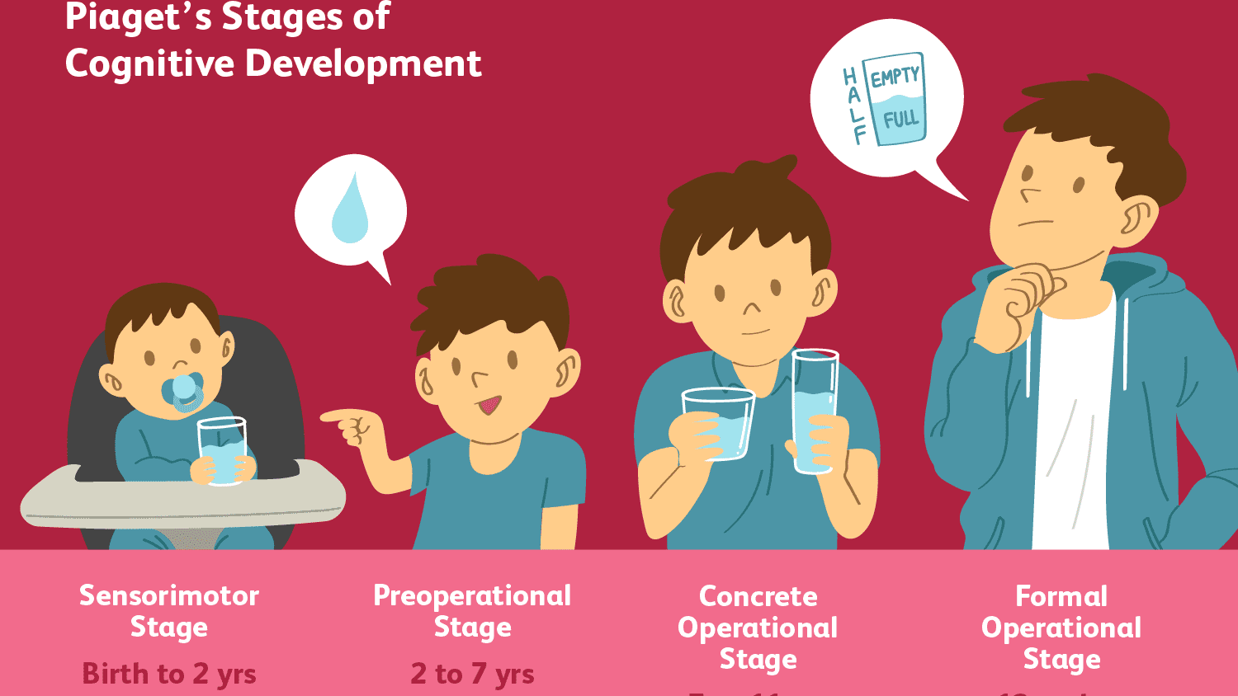
Unit 1: Human Lifespan Development
Topic Summary:
You will be introduced to the biological, psychological and sociological theories associated with human lifespan development. You will explore the PIES development across someone’s lifespan. Examining the factors that affect growth and development such as the environment or genetic inheritance and consider the positive and negative influences on development.
Learning Assessment:
A: Human growth and development through life stages.
B. Factors affecting human growth and development.
C. Effects of ageing.
Physical Signs of ageing
Cardiovascular disease – Older people suffer narrowing of the arteries and other blood vessels due to fats such as cholesterol sticking to the walls of the arteries. This can lead high blood pressure, stokes and heart attacks.
Degeneration of nervous tissue Impulses become slower and age-related changes in function become more noticeable.
Osteoarthritis – degenerative disease – result of wear and tear on the joints.
Degeneration of sense organs – sensory awareness decreases as a part of natural ageing.
Reduced absorption of nutrients – due to restricted physical activity and natural ageing, the body's ability to absorb and gain nutrients is reduced therefore older people need nutrient and vitamin rich diets.
Dementia (Alzheimer’s disease, Dementia with Lewy Bodies, Vascular dementia) Dementia is an umbrella term for conditions affecting a person's normal brain function, making every day tasks such as communication more difficult.
Effects of illnesses that are common in ageing. - the impact of illness on a person can be significant. It can lead to depression, social isolation, lose of mobility, insomnia etc.
Theories
Social disengagement theory (Cumming and Henry, 1961) - Overtime elderly people withdraw and disengage from social roles.
Activity theory (Havighurst, 1960s) - when older people remain socially active the ageing process is delayed, and quality of life maintained.
Theories
Piaget (logic and reasoning) – stages of cognitive development, schemas, test of conservation, egocentrism. - The idea that children construct their own understanding of the world through their interactions with it. Children's thinking develops from one stage to the next and their behaviour changes.
Chomsky – Language Acquisition Device (LAD). Children are born with the ability to learn any human language.
Attachment Theories – Bowlby (1958) and Ainsworth (1978) attachment to a care giver is an important part of social, emotional and cognitive development from birth.
Holmes-Rahe social readjustment rating scale – looked at 43 different life-events and gave each a score. For each individual they looked at their life events over the last 2 years and added the scores up. The higher the total score the higher the risk of a stress related illness.
Psychological changes of ageing
• Effects on confidence and self-esteem
• Effects of social change:
- Role changes
- Loss of a partner
- Loss of friends
- Increase in leisure time
• Financial concerns
• Effects of culture, religion and beliefs
• Social disengagement theory (Cumming and Henry, 1961)
• Activity theory (Havighurst, 1960s)
Nature Vs Nurture theories.​
Gesell’s maturation theory​ - development is determined mostly by internal factors controlled by the genes (Nature)
​
Bandura’s social learning theory.​- People learn through observation, imitating and modelling other's behaviour (Nurture)
​
Stress-diathesis model.​ Link between a predisposition (nature) and life experiences (Nurture) combined.
​
Societal effects of an ageing population
Health and social care provision for the aged
• Needs assessment
• Winter assistance
• Meals on Wheels
• Day centers
• Residential services
• Sheltered housing
• Home care
• Tele care
Economic effects of an ageing population
• Strain on NHS and Health and Social Care Services

