Slide 1
BTEC Level 3 Health & Social care Unit 2 Working in health and social care knowledge organiser

Slide 2
Health roles | Day to day Responsibilities
Doctor | Prescribe treatment - to treat conditions Talk to and examine patient to diagnose condition Carry out specific procedures e.g. specialist investigations or operations Make notes and prepare paperwork - as a legal record of treatment Liaise with medical and non-medical staff - to provide general care Promote health education to maintain patients health Follow policies and procedures to promote his rights
Midwife | Provide advice to support with health during the pregnancy. Provide information about the development of the foetus/baby. Provide advice and carry out monitoring of mother during the pregnancy. Support mother and her partner to put a birthing plan in place. Provide parenting sessions. Provide information on labour to mother and her partner. Support during labour/ after - Provide advice and support on how to care for the baby. Observe mother and partner feeding, bathing and changing the baby. Liaise with other professionals
Health care assistant | Following policies and procedures. Working as a part of a team to provide Jason’s personalised care. Assisting in giving medication/treatments. Monitor Jason’s condition. Providing personal care/ supporting washing and dressing. Supporting Jason’s eating and drinking. Providing advice/emotional support to Jason.
Occupational therapist | Assessment of physical needs - to identify appropriate adaptations Keep accurate records - to monitor effectiveness of adaptations Advise on adaptations - to support activities of daily living Teaching use of aides - to support his independence Attend multi-disciplinary meetings - to plan and review ongoing care Follow organisational policies/procedures - to provide consistent care
E.g. The hospital doctor must follow all policies and procedures(1). This will ensure they are carrying out good working practice promote his rights.(1)
Another responsibility is prescribe treatment (1) to treat Laidan’s condition (1).
E.g. The health care assistant must follow all policies and procedures(1). This will ensure they are carrying out good working practice.(1)
Another responsibility is to support Jason with eating and drinking(1). This will ensure his physical needs are met(1).
They also provide Jason with advice and emotional support (1). This help Jason meet his emotional needs (1).
A midwife will provide advice to support Jessica with her health during the pregnancy. Jessica will attend regular appointments with the midwife where they will provide information to her about the development of the foetus/baby.
During these appointments the midwife will also carry out monitoring checks such as urine and blood pressure. This is to ensure if any complications arise they will be dealt with.
The midwife will support Jessica and her partner to put a birthing plan in place. For example Jessica partner may want to cut the cord or discuss what pain relief options Jessica would like.

Slide 3
Promoting anti-discriminatory practice
Promote rights
Ensure good working practices
So service user feels valued and included
Follow the Equality Act 2010
Adhere to codes of practice/professional guidelines
Challenging direct/indirect discrimination
Anti-discriminatory responsibilities
To implement policies
Using communication strategies
ensure equality of care/ best practice
to enable service to express their choices

Slide 4
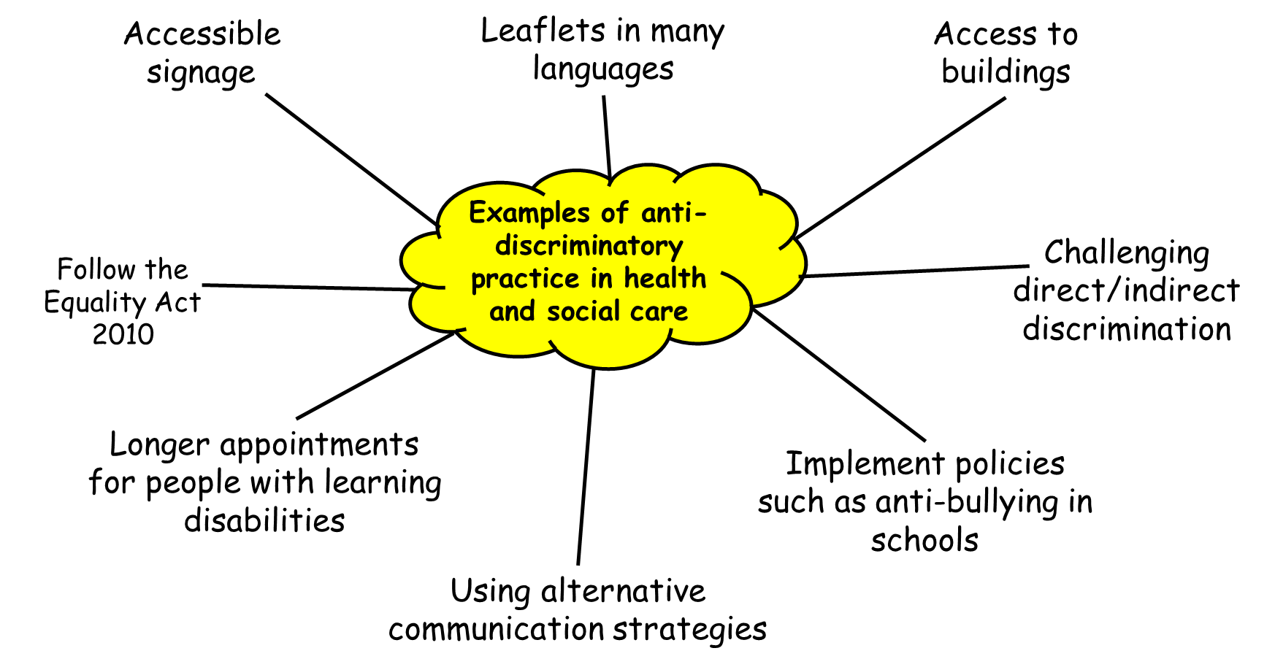
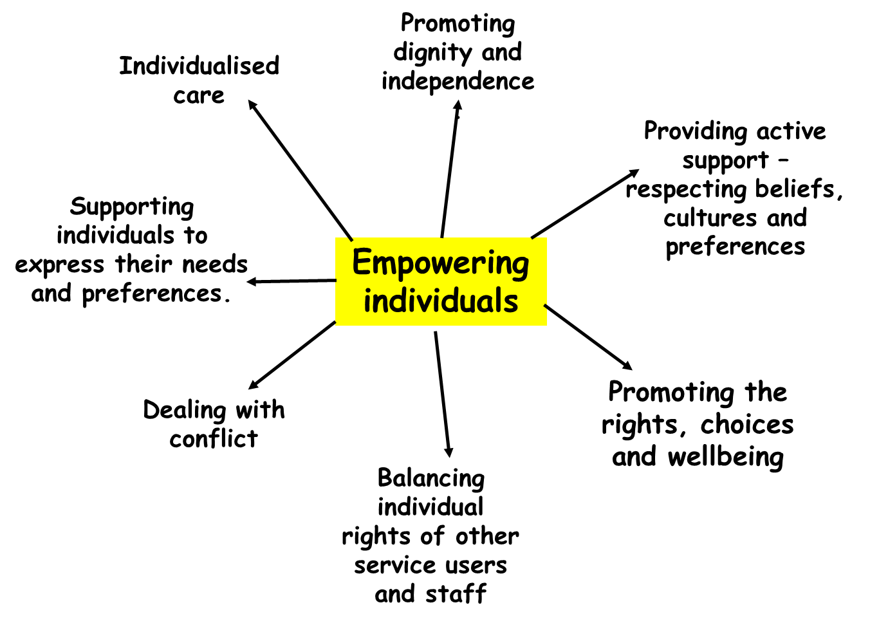
Promoting anti-discriminatory practice
Empowering individuals
e.g. hearing impairment adjustments.
How can staff empower service users?
Staff could empower service users by involving them in the planning of care (1) For example giving them the information needed and option of where she would like to to spend her last months at home or whether in end of life care (1).
Staff must also provide support and treatment that meets the requirements of service users beliefs, culture and preferences (1). For example if she is vegan, when receiving treatment in hospital staff must provide her with a diet meeting her preferences, contain no animal products (1).
Staff must also promote service users dignity and independence (1). For example before providing treatment or meeting her care needs professionals must gain consent to maintain her dignity and independence (1).
To implement policies (1) ensure equality of care (1).
Adhere to codes of practice/professional guidelines (1) ensure good working practices (1).
Follow the Equality Act 2010 (1) promote rights (1).
Challenging direct/indirect discrimination (1) so Nicky feels valued and included (1).
Using communication strategies (1) to enable Nicky to express her choices (1).
Empowering Nicky (1) by promoting individualised care (1).

Slide 5
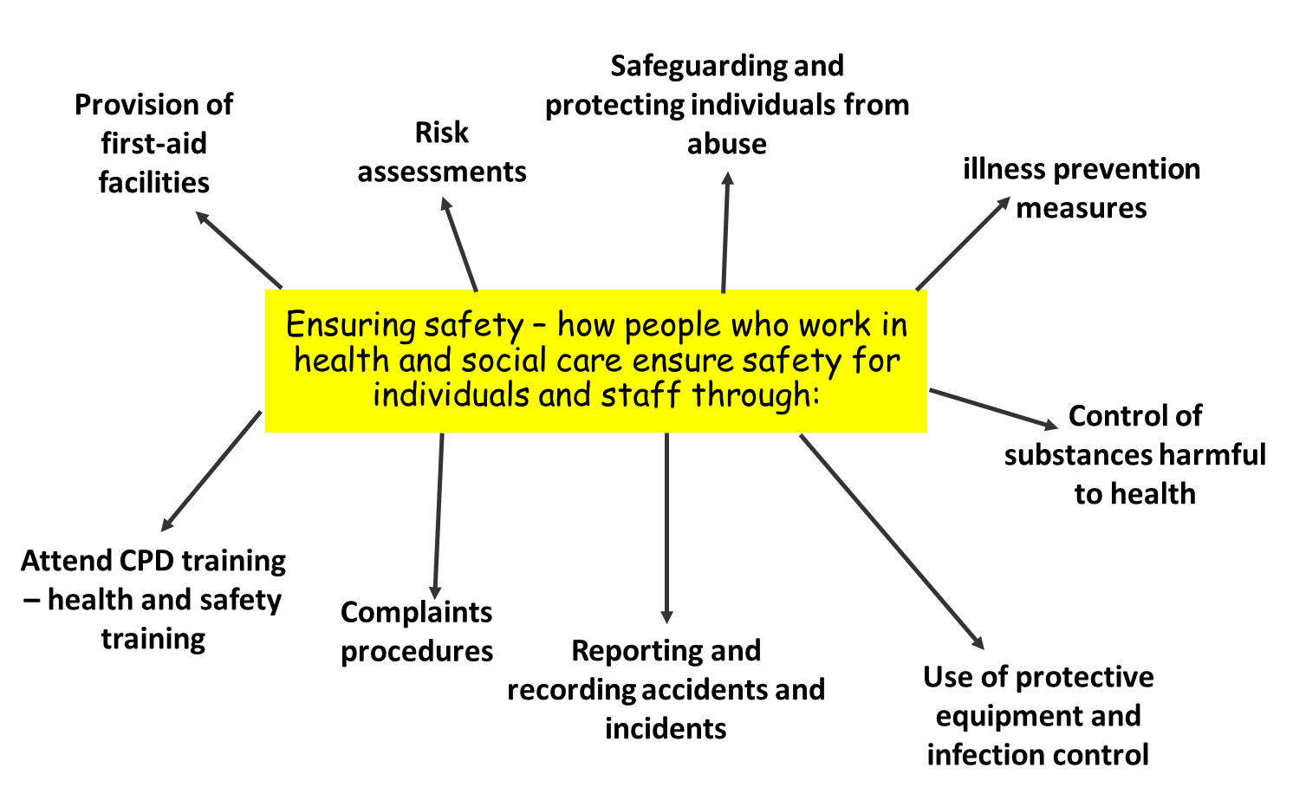
Ensuring safety
Information management/communication
treat information about patients with confidentiality
communicate with relevant individuals
pass on medical information, e.g. from GPs to hospital consultants where further treatment is needed
obtain permission when information about is shared
share information in a way people understand according to their needs (alternative forms)
respect the legal responsibilities of disclosing information/data protection
follow policies and procedures
implement protection measures, e.g. for those who are the focus of the information and the professionals who manage the cases.
Explain how Jake can be kept safe while in hospital. (6)
Risk assessments.
Following policies and procedures.
Safeguarding and protecting from abuse.
Regular training for staff.
Monitoring of staff including regular line management meetings.
Monitoring visitors to the ward.
Effective complaints and whistleblowing procedures.
Monitoring infection control procedures.
Ensure adequate PPE provided.
Confidentiality procedures followed – involve parents.
Accurate records maintained.

Slide 6
Multidisciplinary working in the health and social care sector
Q How can multidisciplinary team can support service users:
The need for joined-up working with other service providers.
Range of specialists involved to meet all needs.
Holistic care ensuring all areas of support are addressed.
Ensures gaps in provision are addressed.
Ensure that service user is involved in planning and decision making.
Provide access to an advocate to ensure service user can voice preferences and choices.
Review of care plans to monitor the effectiveness and make appropriate changes.
Promote their rights.
Assessment identifying the different needs that can be effectively met by multidisciplinary working.
Care planning cycle, monitoring and regular reviews.
Problems may include gaps in services, professional conflicts, poor communication, lack of a seamless service, inadequate funding.

Slide 7
Monitoring the work of people in health and social care settings
Line management | Hierarchical organisations/ work is monitored by senior members of staff/ Line management meetings/ observations from senior staff or line manager. 1. If staff performance falls short of the practice expected - line managers responsibility to address 1. First instance – may be an informal conversation or warning 2. If the concerns are serious or there is no improvement in performance more formal action may be taken which could finally lead to suspension or dismissal.
External inspection by relevant agencies | Care Quality Commission (CQC) – Inspect health and care provision Ofsted – Inspect Early years and education services
Whistleblowing | When a member of staff is aware that the quality of care at their workplace is dangerously poor and reports this to bring about change. Inform the press or another powerful organisation outside the setting – police or professional body – CQC
Service user feedback | Regular meetings for service users to report concerns and share ideas for the improvement of provision In a large setting - may be a committee that represents the views and interest of the service users e.g. parents and carers association at a pre-school setting. a suggestion box A private meeting might be organised with a manger or person in charge of the setting Service users reporting good practice or areas of concern to the external agencies e.g. Ofsted or CQC.
Criminal investigations | In extreme circumstance such: as cases of sexual, physical, financial or emotion abuse/ when it is suspected that criminal law has been broken The police will investigate.
Service user feedback to improve provision so there is sufficient staffing and resources in place to meet needs.
External inspection by relevant agencies e.g. CQC to check that staff understand how to implement the hospital’s policies.
Staff have access to relevant continuous professional development.
Complaints investigated promptly and properly.
Whistleblowing encouraged.
Line management with a staff appraisal system to monitor the quality of the work undertaken and any additional training needs.
CCTV

Slide 8
Barriers
Cognitive barriers - Not understanding the information that is provided.
Perception issues – lack of accurate information and support.
Psychological/emotional barriers - caused by other people’s attitudes leading to feelings of isolation or being stigmatised. Lack of confidence - may prevent services from seeking services.
Individual preferences to see a specific health or social care worker.
Lack of awareness of the resources available.
Resources barriers - Lack of resources/bed blocking may mean the
Physically accessing services may be difficult/ Mobility barriers such as unmarked steps.
Geographical location and cost of transport to get to the service providers.
Financial constraints may limit choices if services not locally available/ Poverty and associated extra costs related to managing an impairment – social care support, other mobility and communication adaptation aids.
Geographical/transport issues may make it difficult to attend appointments.
Social/family concerns may dissuade from attending.

Slide 9
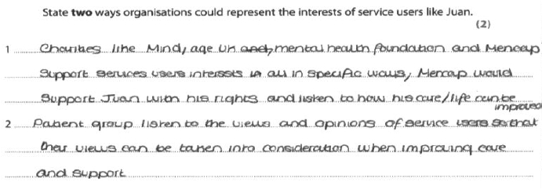
Ways organisations represent interests of service users
Identify two ways charities could support Laidan. (2)
Provide an advocate.
Provide information and advice.
Provide equipment/resources.
Provide access to support groups.
Support access to health and social care services.
Provide emotional support/befriending service
Charities/patient groups | Represent the service users when they need to contact and liaise with other official agencies e.g. Mencap - represent their service users and support them if they are liaising with other organisations such as local council housing department, social services etc.
Advocacy | Advocate may speak on their behalf. Getting to know them Build trusting relationship so that they can accurately represent the needs, wishes and preferences of their client to the professional workers Attend care meetings, completing forms, writing letters or emails on the clients behalf. e.g. clients may have learning difficulty, a speech impairment, poor literacy skills, a limited grasps of English or lack confidence when talking with professional health and care workers.
Complaints policies | All care settings MUST have formal complaints procedures The setting has a responsibility to ensure that their service users, families and other informal carers, understand how to access and use complaints procedure if they are unhappy with quality of care provided. All processors and outcomes of any complaints will be checked whenever the setting is inspected.
Whistleblowing policies | Provide protection for staff who tell the press/ other organisations (outside the setting) that the quality of care at their workplace is dangerously poor. e.g. if they report a situation to the media, the police or to a professional body in order to heighten aware of the problem and to bring about change.
State two ways organisations could represent the interests of service users like Juan (2)

Slide 10
Organisations that regulate settings
CQC | Monitor and inspect health services and adult social care services
PHE | Organised strategies to prevent disease, promote health and prolong life in a population. Health promotion, Research projects & Taking measures to protect nations health.
NICE | Provides guidance on current best practice in health and social care.
OFSTED | Regulate and inspect services that educate children, young people and adults or care for children.
Organisations that regulate professions
Nursing and Midwifery Council (NMC) | Nurse & midwives
Health and Care Professions Council (HCPC) | Social workers, physiotherapist, occupational therapists
General Medical Council (GMC). | Hospital doctors & general practitioners
Role of organisations that regulate professions:
Purpose - protect the public by setting standards of education, training, professional conduct and professional practice to ensure high standards are maintained throughout.
sets standards and formal code of practice/ make sure staff are aware
Ensures professionals have to provide evidence of CPD and training to remain on register - kept up to date with new developments/ approaches
Makes sure professionals are qualified/ have the correct qualifications
Ensure professionals are registered with NMC, GMC or HCPC
They will investigate any allegations/ complaints that their members are not meeting standards set
have power to restrict practice - work under supervision or attend more training
Has power to remove from register if not fulfilling the role

Slide 11
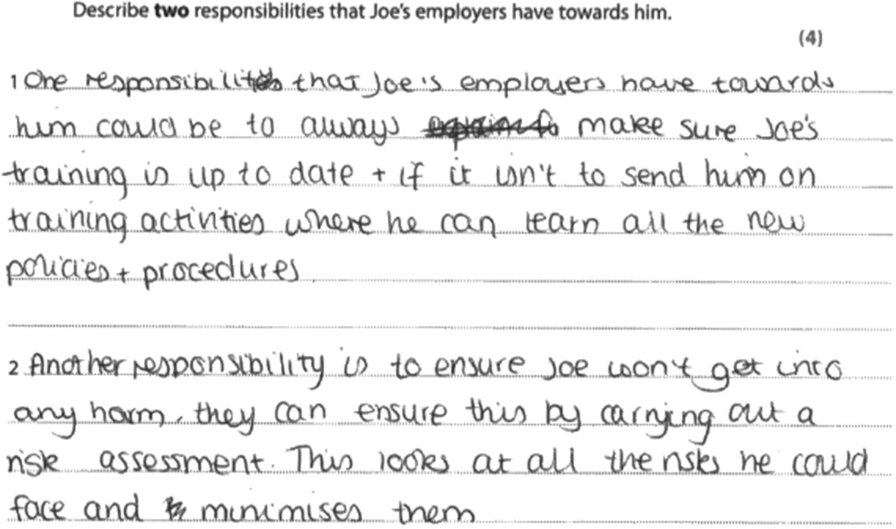
Employer responsibilities.
Implement codes of practice | Manager must ensure all staff understand how to implement the codes of practice in their workplace and how to meet current national occupational standards (NOS) for their role.
Meet national occupational standards (NOS) | Describes best practice Standards of professionals practice that should be met in the workplace Underpin codes of practice & curriculum for training Cover standards also included in the codes of practice set out by professional bodies (GMC, NMC and HCPC)
Undertake continuing professional development (CPD) | CPD to maintain high standards and continually update their skills/ Following best practice and most up to date procedures based on research. GMC, NMC and HCPC – under these staff are required to complete regular professional training to remain on their registers
Safeguarded | Have internal (within the setting)/external (CQC or police investigation) complaints dealt with properly Take part in whistleblowing Have membership of trades unions/professional associations (BMA – doctors and RCN - nurses) support professionals during conflict or issues within their role – between them and the employer Follow protocols of regulatory bodies (Code of practice set out by GMC, NMC and HCPC)
Describe two responsibilities of the hospital to ensure that its workers meet National Occupational Standards. (4)
Describe two responsibilities that Joe's employers have towards him. (4)
Provide staff CPD training sessions (1) to make them aware of current accepted practice (1)
Update policies and procedures (1) to ensure staff meet legislative requirements (1)
Make sure staff are aware of the codes of practice (1) implement practice (1)
Complaints/ whistleblowing procedure (1) meet professional duty (1)
Provide CPD/ Training (1)
Ensure he can apply organisational policies (1)
Meet NOS (1)
Staff safeguarding (1)
Whistleblowing (1)
Complaints procedures (1)

