Slide 1
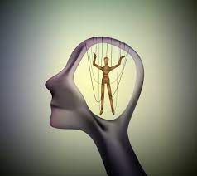
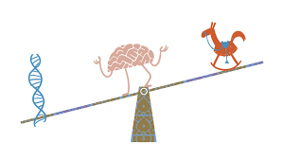
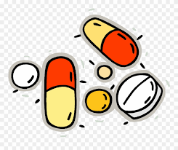
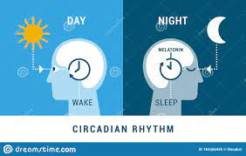
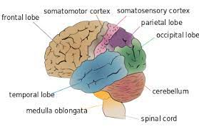
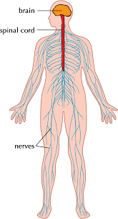
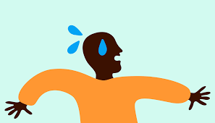
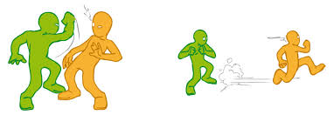
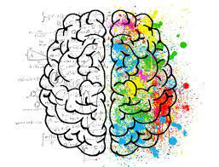
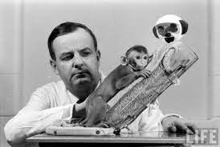
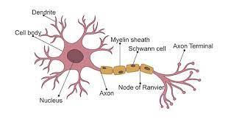
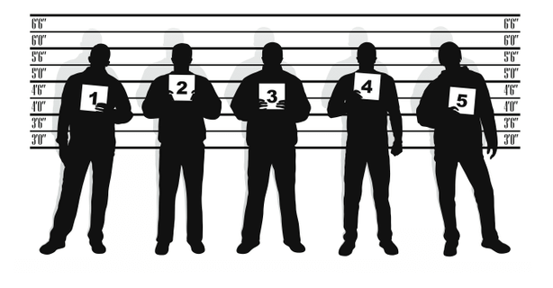
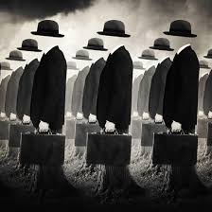
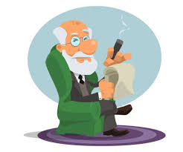
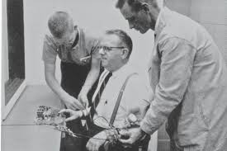
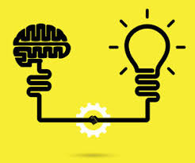
Psychology learning journey
Read like a psychologist
The brain that changes itself: stories of personal triumph from the Frontiers of brain science – Norman Dodge
Obedience to Authority: An Experimental View by Stanley Milgram
The Lucifer Effect: Understanding How Good People Turn Evil by Philip G. Zimbardo
Patterns of attachment – Mary Ainsworth
The man who mistook his wife for a hat – Oliver sacks
Key studies in psychology – Gross
Examples of careers in Psychology
Clinical psychologist, play therapist, sports psychologist, genetics counsellor, marriage/family therapist, mental health nurse, researcher, educational psychologist, forensic psychologist, marketing specialist, psychometrist.
Uni
Exam skills
Revision
Socially sensitive research
Sexual selection and human reproductive behaviour
Theories of romantic relationships
Virtual relationships
Free will and determinism
Idiographic and nomothetic approach
Research methods
statistical analysis
Gender and culture bias
Nature-nurture debate
Holism and reductionism
Factors affecting attraction
Parasocial relationships
Research methods: year 12 review
Biological explanations and treatments of SZ
Review of year 12
How to change addictive behavior
Gambling addition
Ways of studying the brain
Interactionalist approach to SZ
Year
13
Biological rhythms
ap
Psychological explanations and treatments explanations of SZ
Classification of schizophrenia
Smoking addiction
Localisation of function
Risk factors in addiction
Plasticity and functional recovery
Influence of childhood on adult relationships
Nervous system
Caregiver interaction
Explanations of attachment
Phobias
Research methods
OCD
Fight or flight response
neurons
Depression
Animal studies in attachment
Types of attachment and maternal deprivation
Research methods
Endocrine system
Definitions of abnormality
Eyewitness testimony
Cognitive, learning and biological approaches
Social change
conformity
Models of memory
Year
12
Explanations of forgetting
Origins of psychology and psychology as a science
Research methods
Approaches: psychodynamic and humanistic
Obedience

